Slide 1

GADGETS 360
Name: R. Indra Narayana
Reg.no: 11706250
Introdruction to Data Management(INT217)

Slide 2
Objectives
1. No of smartphones of different brands launched in different year.
2. Analysis on the price of smartphones.
3. Type of chipset used by various smartphones.
4. No of smartphones having audio jack.
5. Analysis on the basis of operating systems used.
6. No of smartphones support 3g.

Slide 3
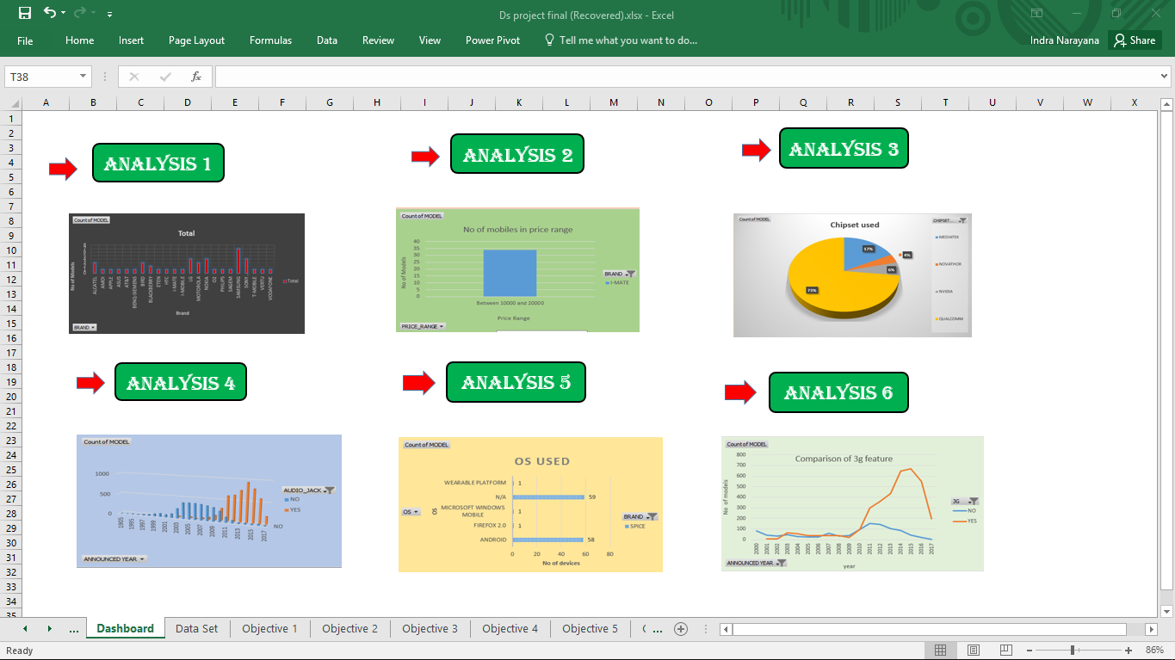
DASHBOARD

Slide 4
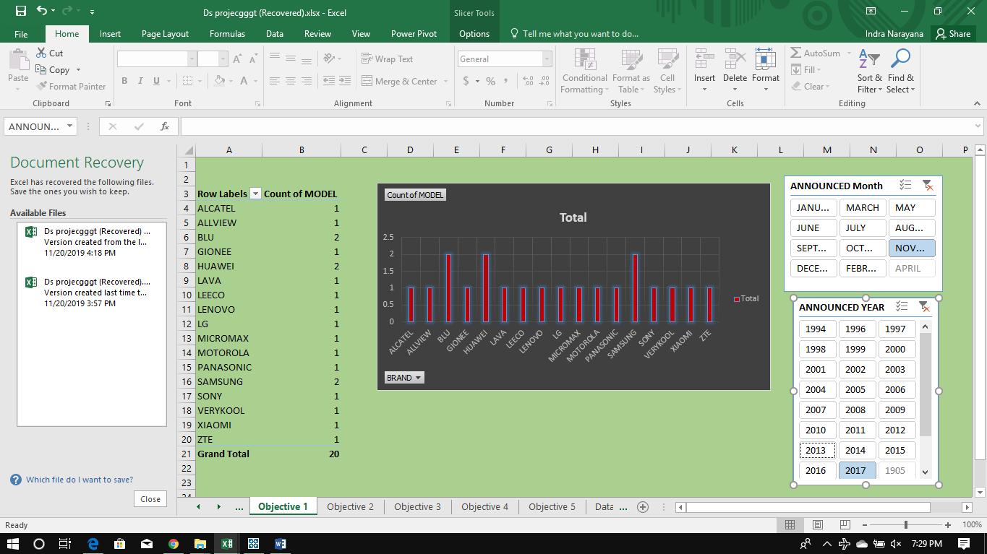
No of smartphones of different brands launched in different year.

Slide 5
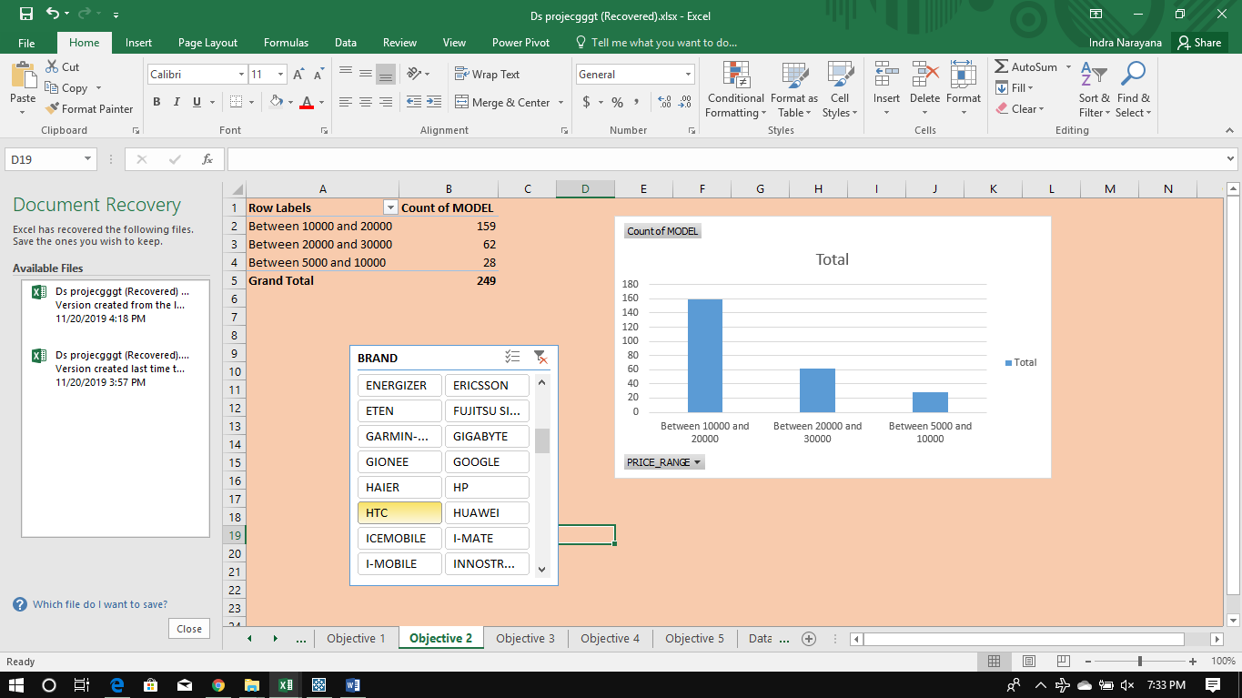
Analysis on the price of smartphones.

Slide 6
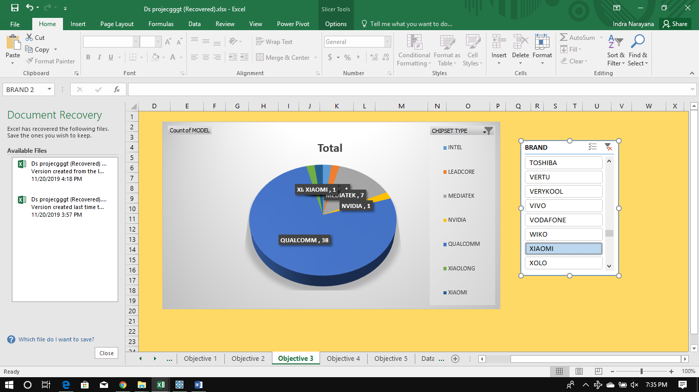
Type of chipset used by various smartphones.

Slide 7
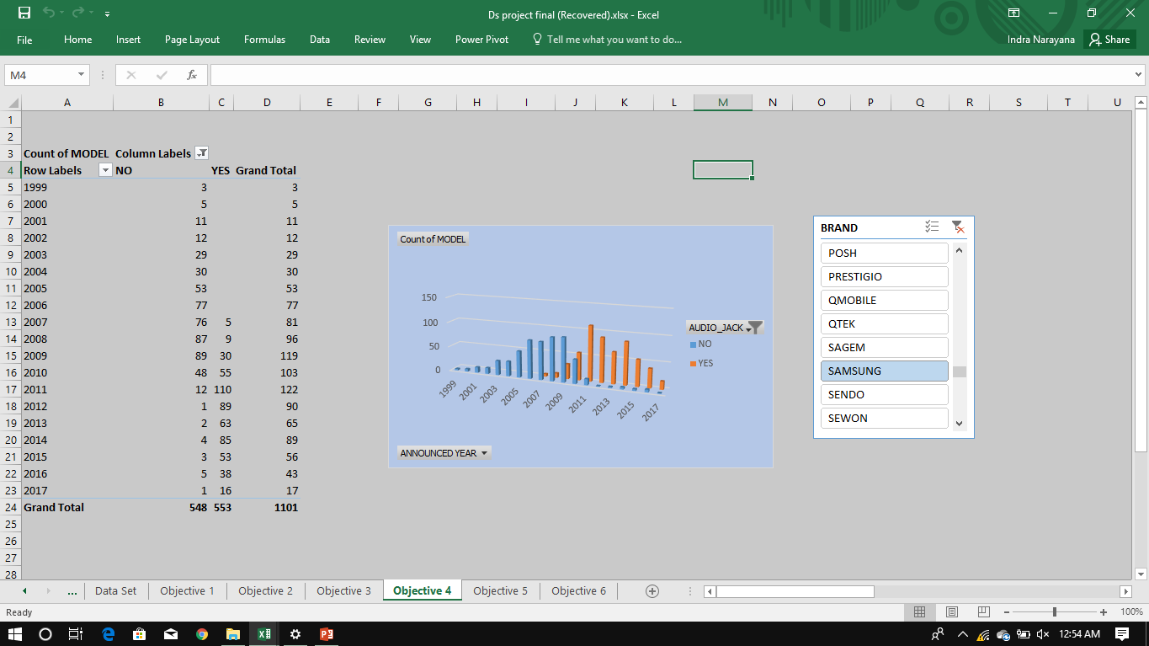
No of smartphones having audio jack.

Slide 8
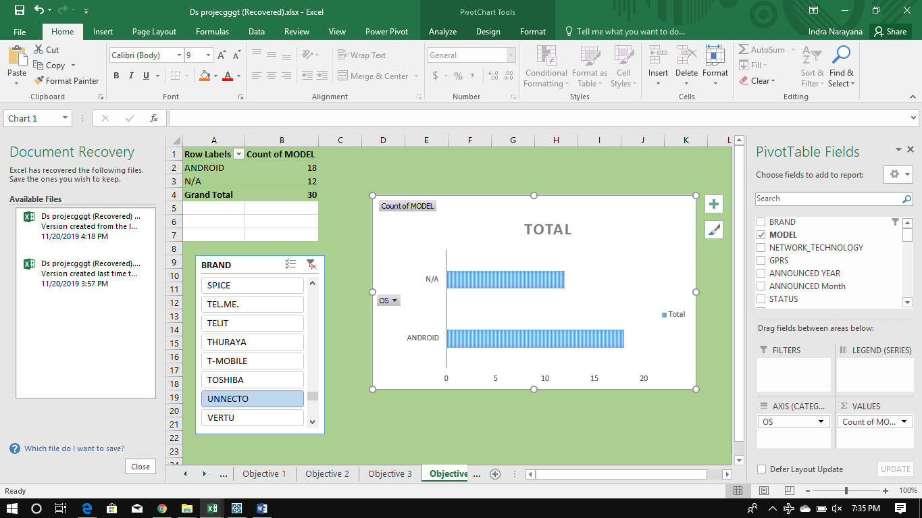
Analysis on the basis of operating systems used.

Slide 9
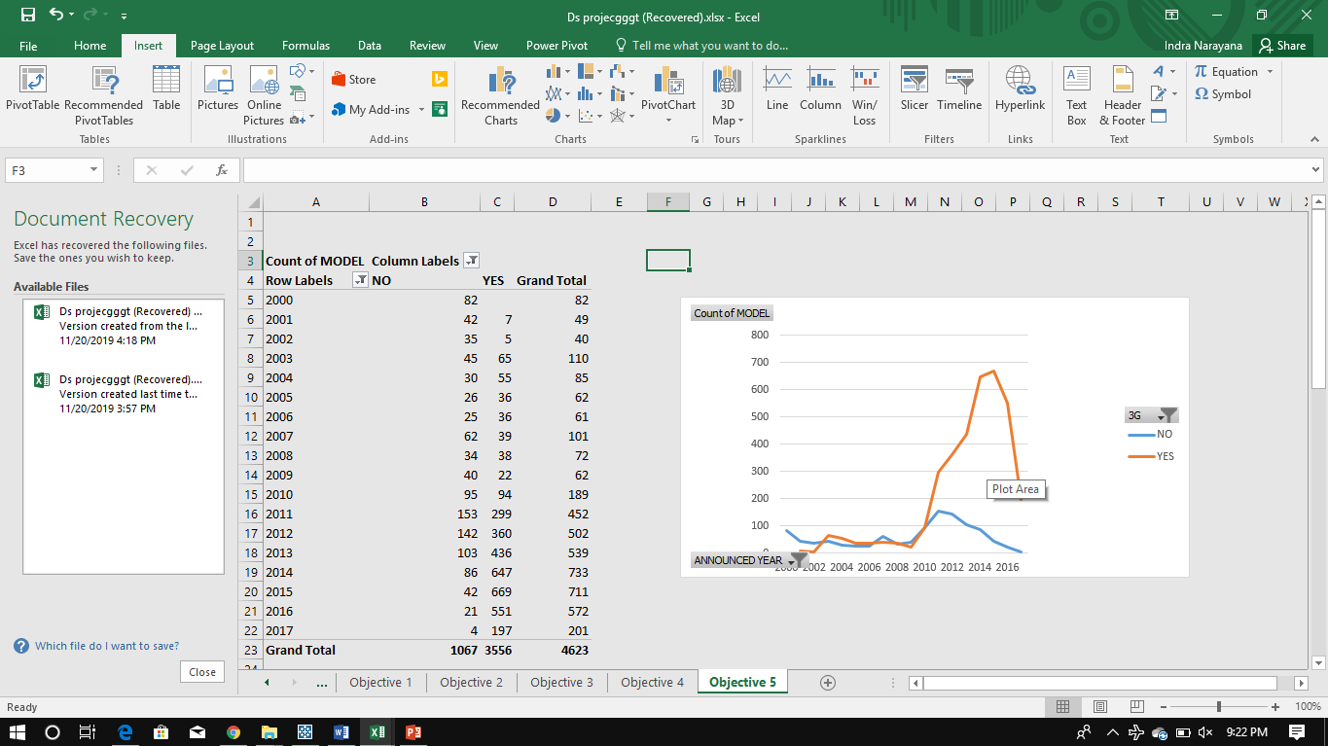
No of smartphones which support 3g.

Slide 10
Conclusions
1. No of smartphones of different brands lauched is increasing yearly.
2. Most of the smartphones are in price range between 10000 to 20000. And apple is the costliest.
3. Type of chipset used by most of the smartphones is Qualcom.
4. Most of smartphones having audio jack.
5. Android os used by most of the devices.
6. 3g is supported by almost all devices launched after 2012.
.

Slide 11
THANK YOU

